Slide 1
UMBC Textbook Marketplace
(The A-Team)
Tuc Nguyen - Amra Mo - Jun Kwon - Hao Wu
Amir Beshir - Sophia Shin

Slide 2
Bio
Tuc Nguyen – Project Manager
Amra Mo - Programmer
Jun Kwon - Programmer
Hao Wu – System Analyst
Amir Beshir – Business Analyst
Sophia Shin – System Analyst

Slide 3
What are we
Our mission is to create an application for UMBC that would serve as a marketplace for students to sell or purchase their textbooks amongst each other as a listing.
We want to provide a safe service where UMBC-only students and alumni can reach out to one another on campus to get rid of their textbooks easier, as well as make money without going through the trouble of selling / purchasing their books by having them shipped off online.

Slide 4
functionality
Listing creation and management
● Ability to create a buying listing or a selling listing
● Fields such as contact information, book information, and pricing.
● Editing and deleting
Student profile creation
● Login
● Contact information
● Picture
Listing browser
● Ability to filter by categories such as buying or selling, price, author, and title.
● Search function, with advanced search, able to search whether a listing is buying or selling, price ranges, catalog numbers, titles, authors, and editions.
Agreement functionality
● When either seller or buyer is interested, the interested party can send their contact information to a listing’s creator. The creator can then decide to message the interested party or not.

Slide 5
Expected value & Constraints
Expected Value:
This app will help students reduce costs when it comes to purchasing books. The application will be able to self sustain itself for many years to come and will only need very minor updates and debugging. We expect to have a profit ranging between $50,000 to $100,000 in the initial startup from sponsorships and advertisements that will be incorporated to make this app free for the users.
Special Issues or Constraints:
● Feedback from beta testers to improve the product.
● Address security issues because student’s UMBC information is linked to their account with the app.
● The system must be operational prior in advance of the academic term starting.

Slide 6
Feasibility Analysis
Technical feasibility:
Familiarity with Application
We are familiar with the technology that may be required to create and implement this project, since similar services such as Bookholders, Facebook Market Place, and the UMBC bookstore exists.
Lack of familiarity with technology
However, with our limited skill sets and knowledge, we may not be able to build and fully launch a fully functional product with all the functions that we may want into a mobile application.
Project size
Due to our limited knowledge of how to actually make the product, it can be as hard and as big as our skills may allow. If we want to make a simple but functional product, it may take 2-3 months given our current standing.
Compatibility with existing systems
The product will be able to be used on most web browsers and mobile.

Slide 7
Economic feasibility:
Development Costs: Operational Costs:
Development team salaries Software upgrades
Software licensing fees Hardware repair and upgrades
Data conversion costs Operational team salaries
Development training
Tangible Benefits: Intangible Benefits:
Increased sales Increased market share Reductions in inventory Higher-quality products
Reductions in customer complaints Improved customer service
Increased brand recognition

Slide 8
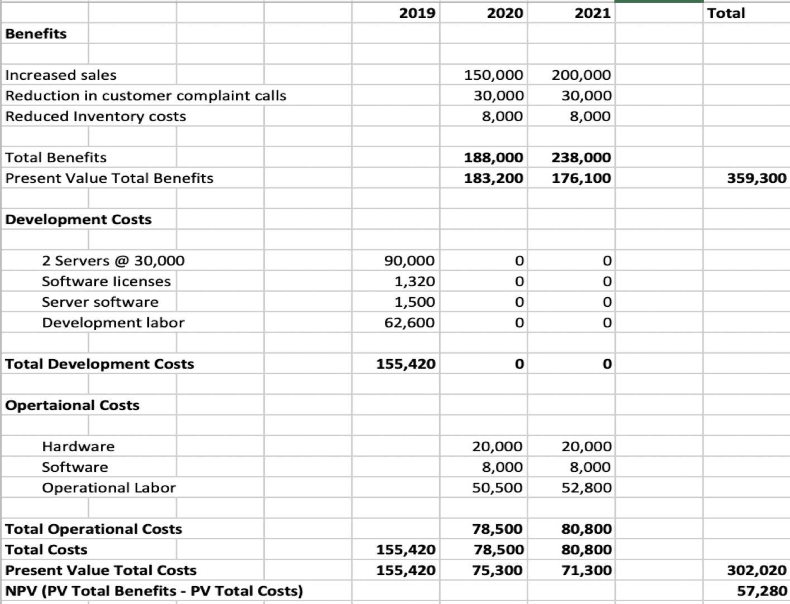

Slide 9
Organizational feasibility:
Organization members
The structure of our organization is very diverse. This limits the number of stakeholders. As of now, the only stakeholders are the current founders, Tuc, Amra, Jun, Hao, Amir, and Sophia. We all have a base foundation of coding but we individually have experience in particular aspects. Tuc has experience as a supervisor, Amra has experience as a network administrator, Jun has experience as a systems administrator, Sophia has experience with web applications, Hao has experience as a systems analyst, and Amir has experience as a business analyst.
Possible partnerships/competition
Possible competition: Other textbook marketplaces like Abebook.com, Textbooks.com, Amazon, etc.
Possible partnerships: UMBC bookstore, UMBC SGA

Slide 10
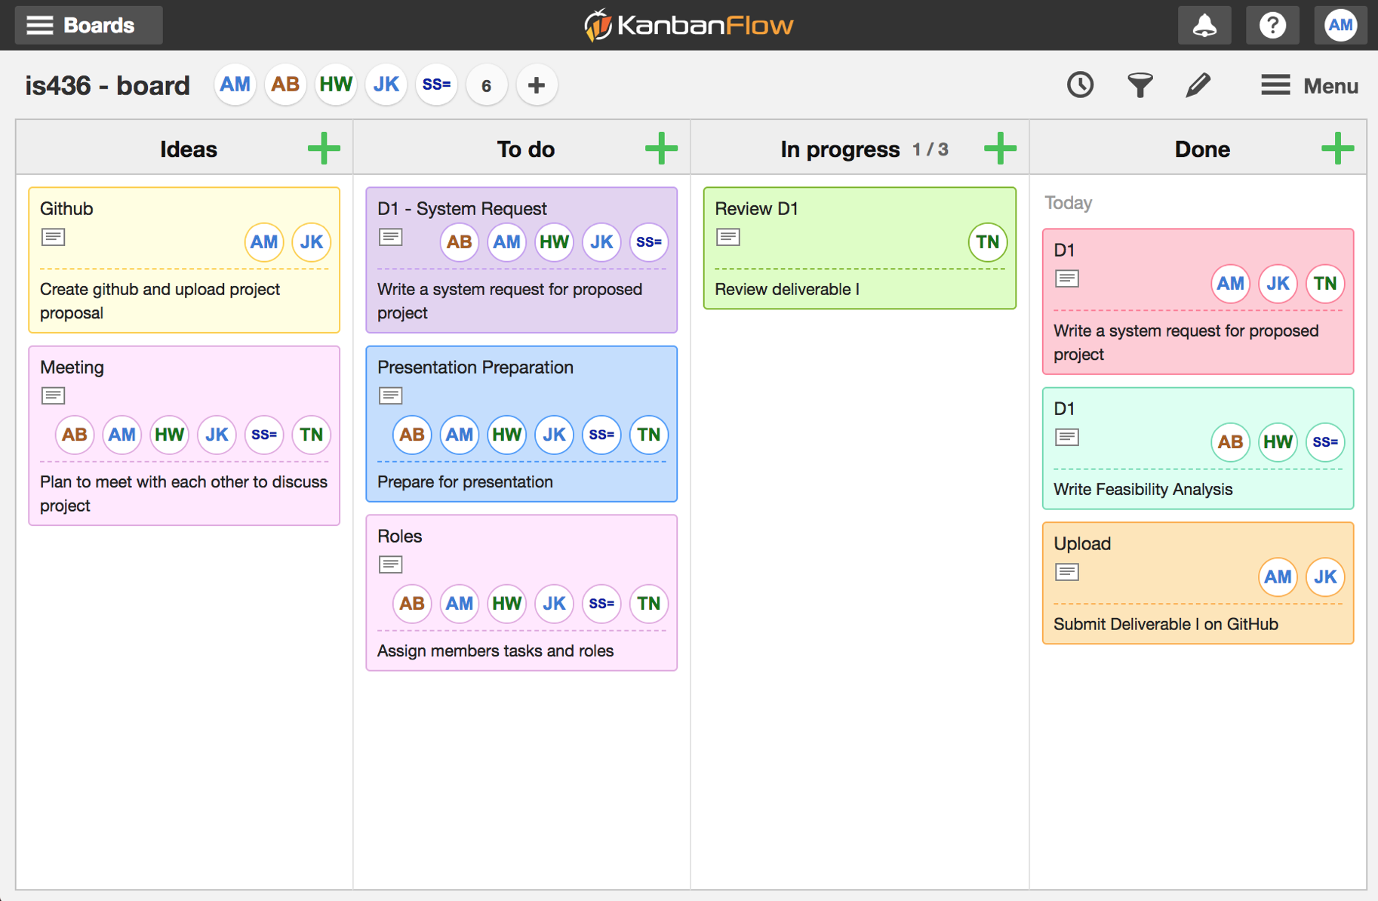

Slide 11
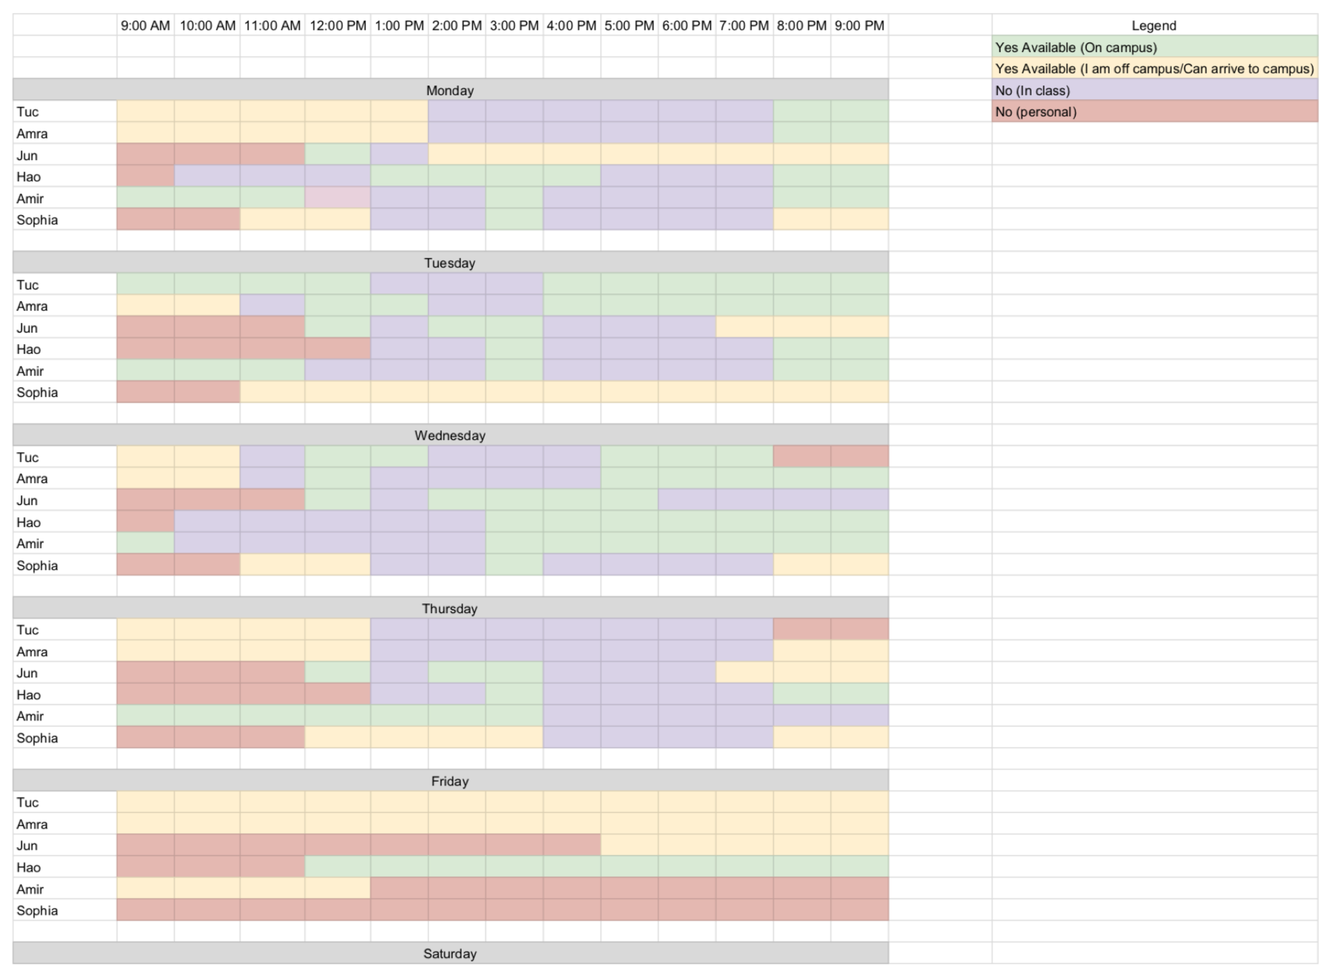

Slide 12
Questions?

